Slide 1
NADA PRESENTATION
Light trucks: Defining the future of driving
SAMUEL IBIKUNLE and UGOCHUKWU ACHARA

Slide 2
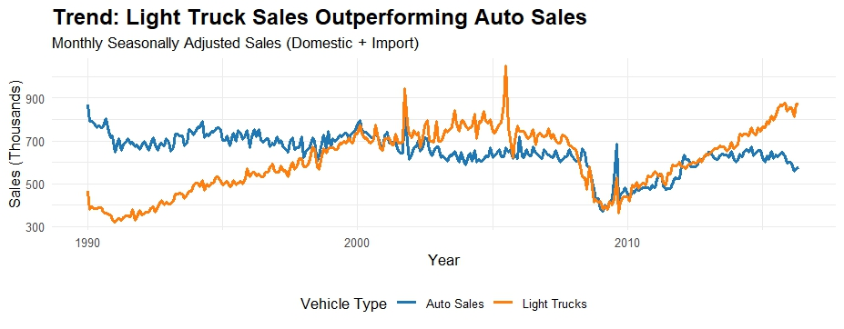
SALES PERFORMANCE TREND
Notes:
pickup trucks, SUVs, and minivans all fall under light trucks
Auto Sedans, hatchbacks, coupe
Data set shows that the consumer started having preference for light trucks starting in the 1990s because they evolved from work vehicles to family vehicles
Slight recession in early 2000’s because of the dot com bubble
Significant drop in the in 2008 due to the big recession
Overall the people’s preference for light trucks hasn’t changed

Slide 3
Recommendation
Inventory allocation
EV options
Strategic realignment
Consumer demand focus manufacturing

Slide 4

References
https://fred.stlouisfed.org/series/ALTSALES
https://www.statista.com/statistics/204342/comparison-of-us-vehicle-production/?srsltid=AfmBOopE9FuILOeJ_kNYA_f4ScMI6FzX4Hli5_Y-FCNACsa5sYSvgGBQ
chrome-extension://efaidnbmnnnibpcajpcglclefindmkaj/https://www.autosinnovate.org/posts/papers-reports/Reading%20the%20Meter%2010-3-2024.pdf

Slide 5
Thanks!
Please keep this slide for attribution

